Slide 1
MIS 632-A: Data Management Lab
Week 3: ER Modeling & Normalization Continued
Mengfang Sun
msun7@stevens.edu

Slide 2
Agenda
erwin demo
Week 3 Homework

Slide 3
erwin Demo
Forward engineering from erwin model to database
Reverse engineering from database to erwin model
Erwin Online User Guide: https://erwin.com/bookshelf/public_html/2020R2/Content/User%20Guides/erwin%20Help/Online%20Help.html

Slide 4
Homework Assignment
Create physical tables for the insurance claims database in the postgres/SQL server instance on your computer
Forward engineer from Erwin to Pgadmin4 OR
Use the “Pgadmin4CreatedTable.sql” SQL script to pgadmin4
Use the “InstructionForSQLServer.sql” SQL script to SQL Server
Submission Requirements:
Screenshot of tables in your Pgadmin4 or SQL server instance
Screenshot of at each of the populated tables
HINT: When importing data into a table with a foreign key, postgres checks to make sure that key exists in the related table. Consider this when you are deciding the order in which to import the tables.

Slide 5
Homework Assignment Notes
We will be using the database we create in this homework assignment to do the class and homework assignments for the next three weeks
If you do not create and populate these database tables in postgres/SQL server, you will not be able to do these future assignments

Slide 6
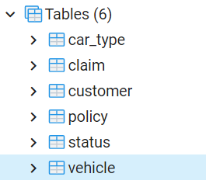
Homework Submission Example Requirement 1
Show tables exist in your database

Slide 7
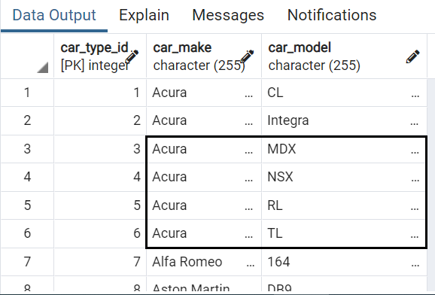
Homework Submission Example Requirement 2
Screenshot like the one above for each of the 6 tables
to show data has been populated

Slide 8
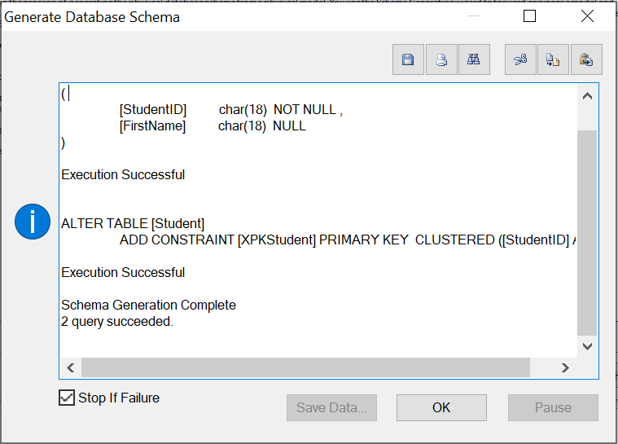
Homework Submission Example Requirement 3(Forward engineer)

Slide 9
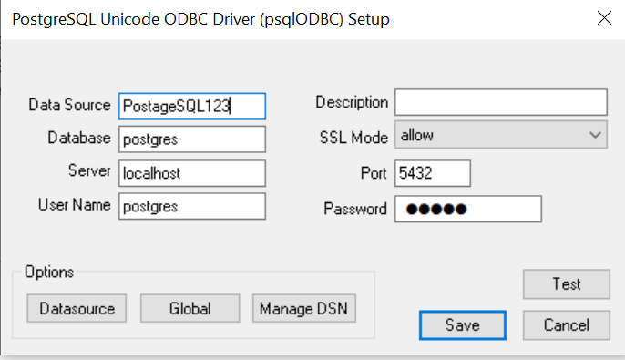
Set up for MySQL
Download
PostgreSQL: File Browser odbc last version
2. Run as administrator
3. Choose second Tab
4. Add PostgreSQL Unicode(*64)
5.

Slide 10
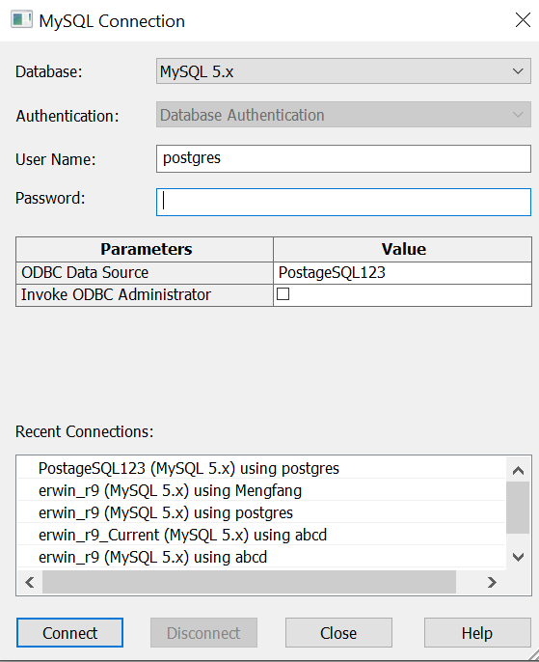
Set up for MySQL
6.

Slide 11
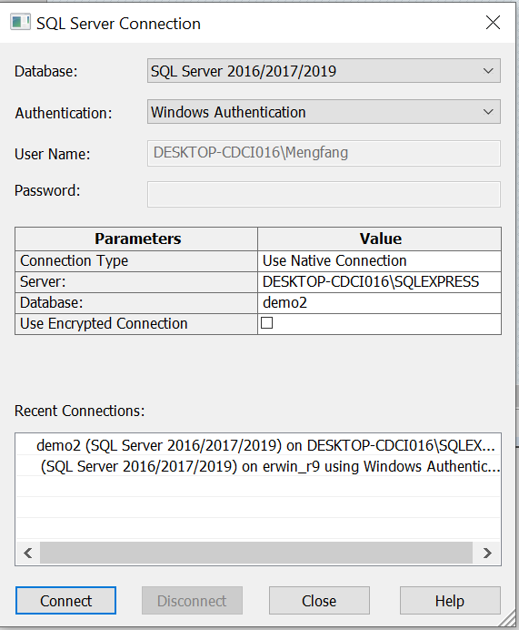
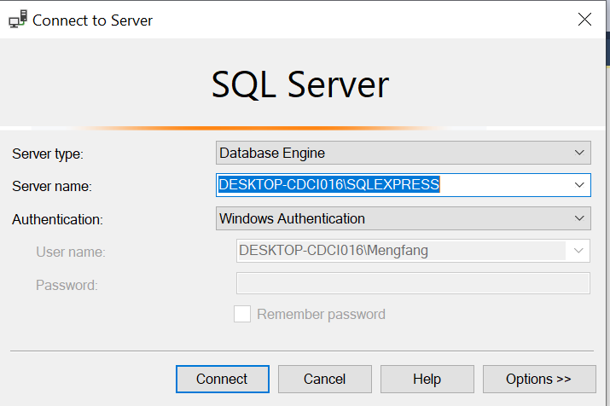
Set up for SQL server
Download sql server 2019: https://www.microsoft.com/en-us/Download/details.aspx?id=101064
Download ssms: https://docs.microsoft.com/en-us/sql/ssms/download-sql-server-management-studio-ssms?view=sql-server-ver15

Slide 12
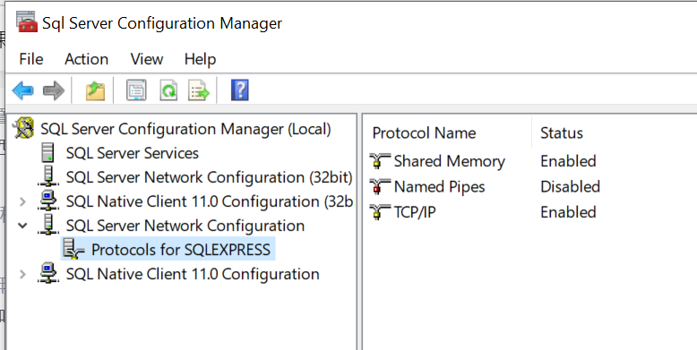
Set up for SQL server
Open Sql Server Configuration Manager
Open ssms, use default value, click connect
In object explorer window, right click, select properties

Slide 13
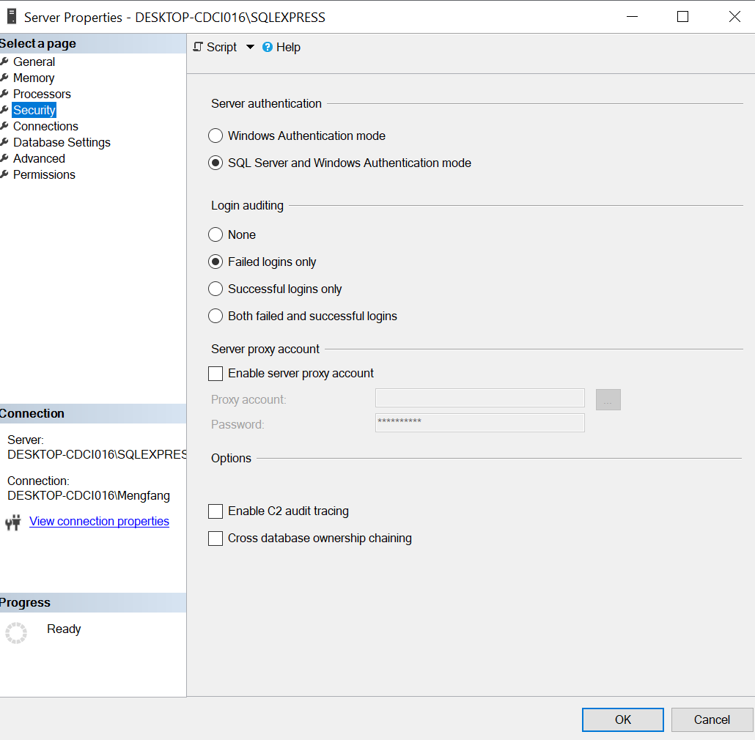
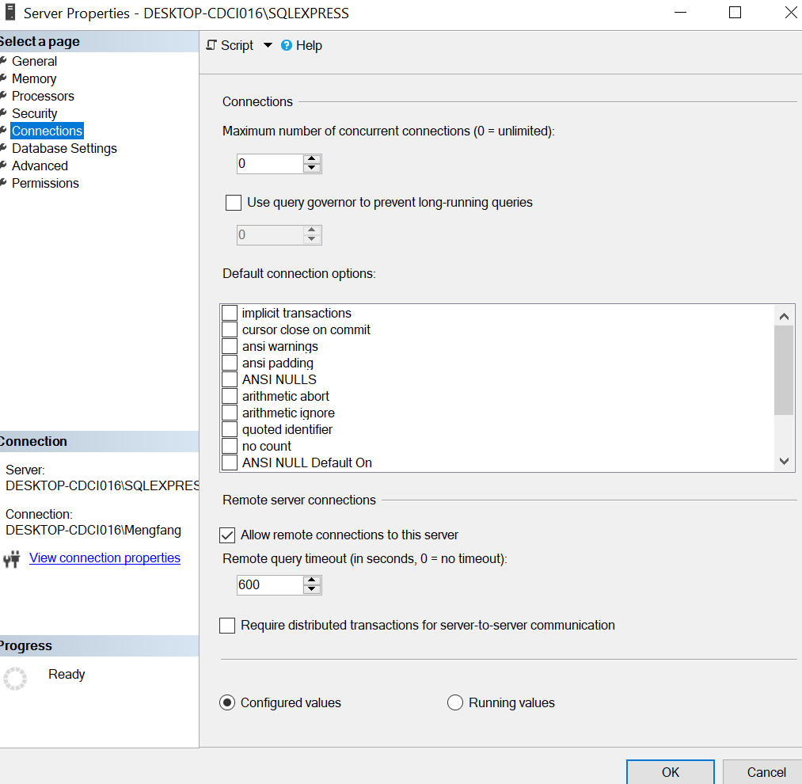
Set up for SQL server
4.

Slide 14
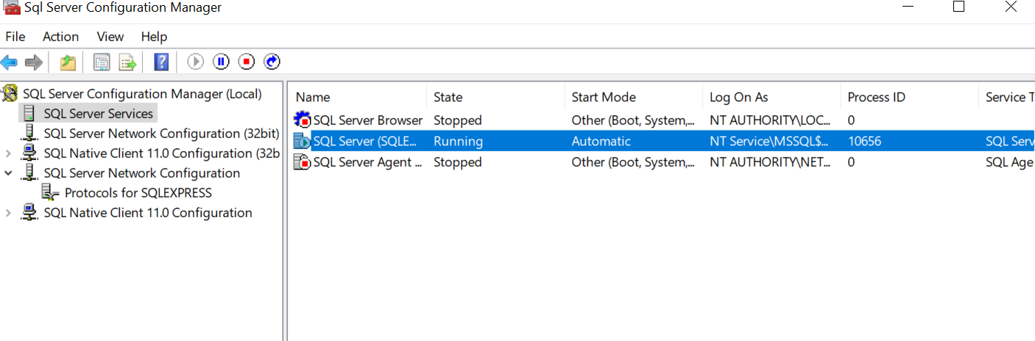
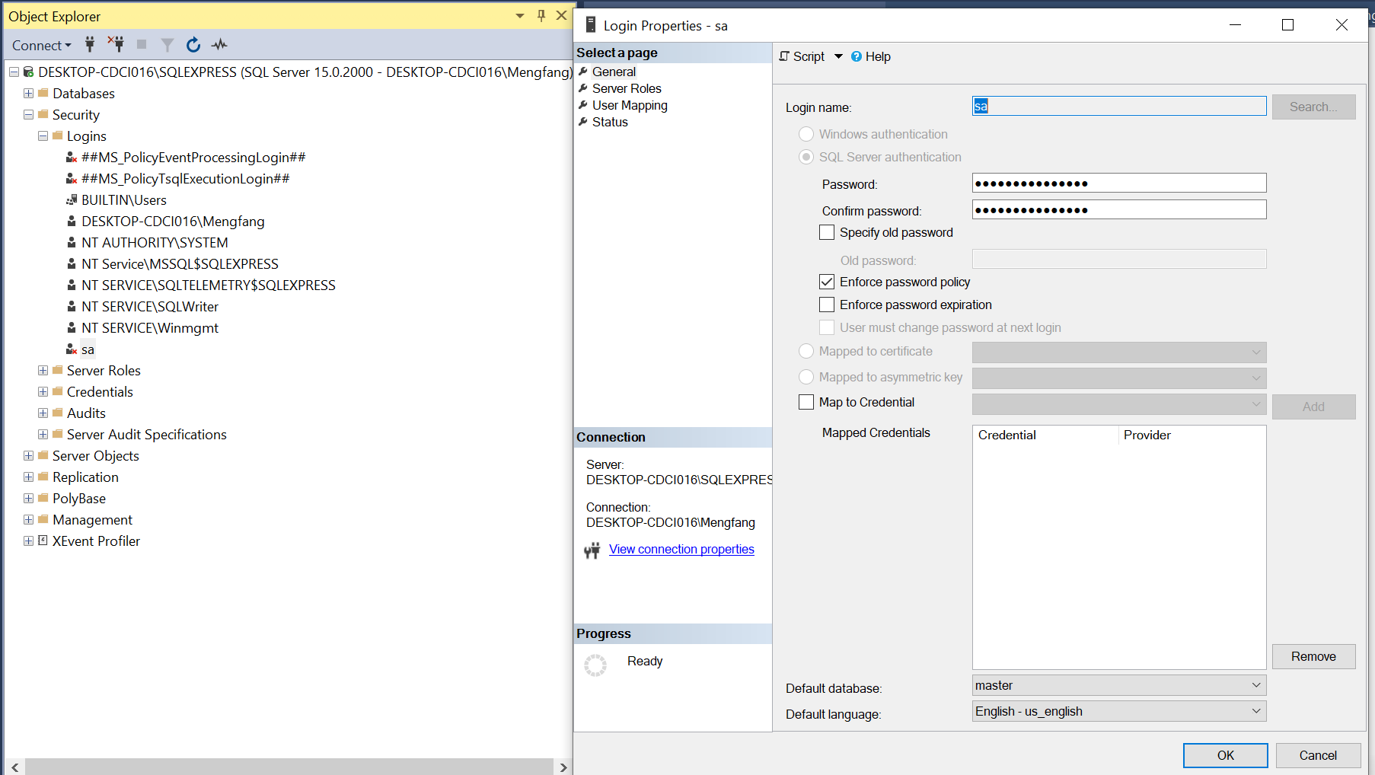
Set up for SQL server
5. Right click SQL Server, select restart
Change login name
Change password

Slide 15
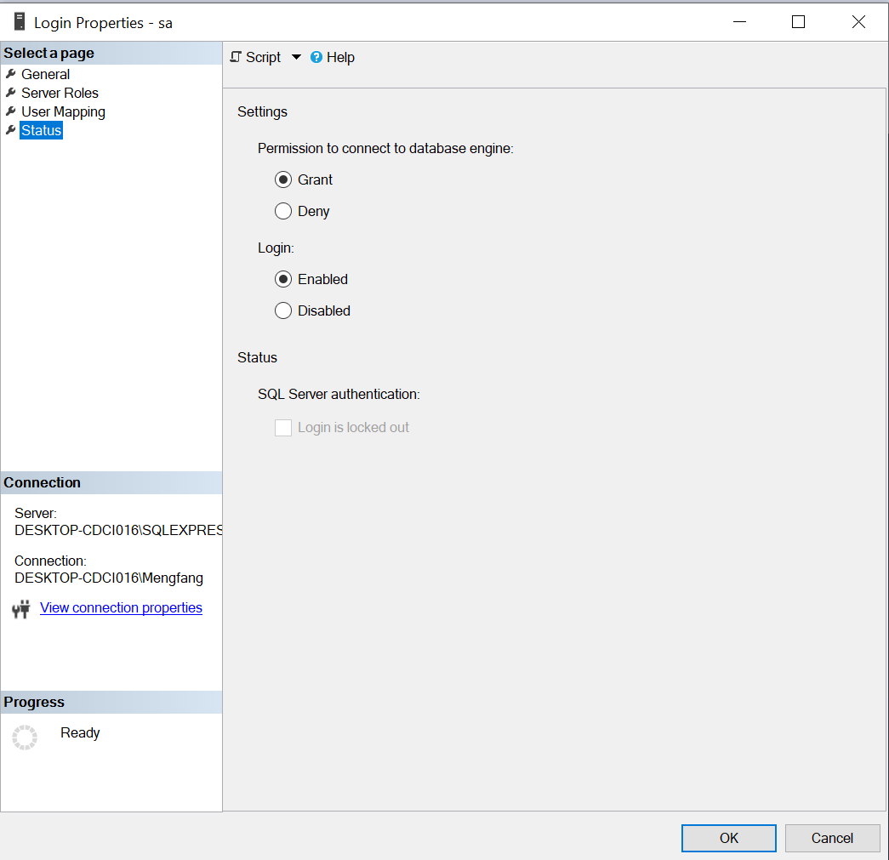
Set up for SQL server
8.

Slide 16
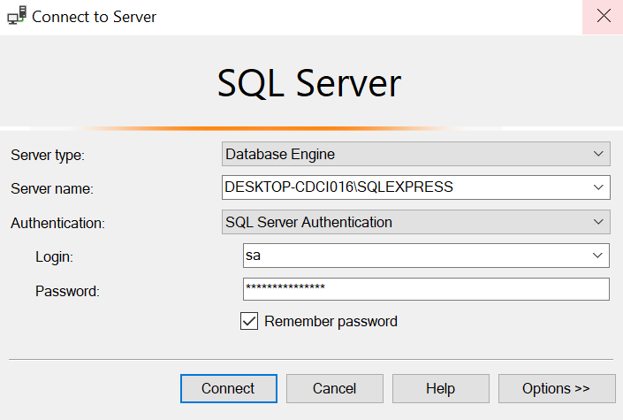
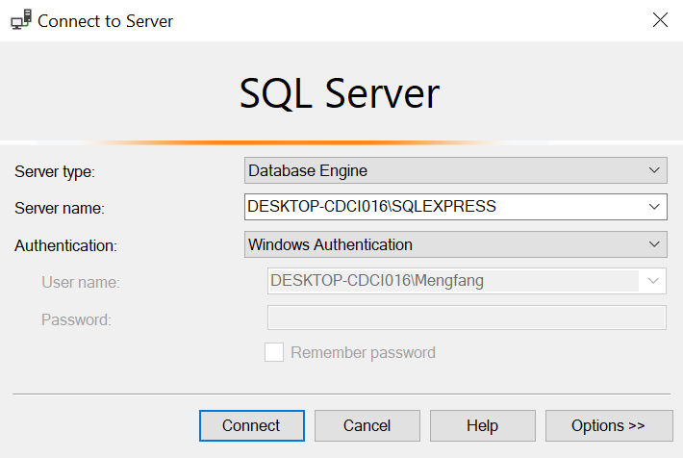
Set up for SQL server

